Slide 1
Mushroom Classification System
Implemented by :
~ Ayush Poojari

Slide 2
ABSTRACT
Mushrooms have been consumed since earliest history. The word Mushroom is derived from the French word for Fungi and
Mold. Now-a-days, Mushroom are popular valuable food because they are low in calories, carbohydrate, Fat, sodium and also
cholesterol free. Besides this, Mushroom provides important nutrients, including selenium, potassium, riboflavin, niacin,
Vitamin D, proteins and fiber. All together with a long history as food source. Mushroom are important for their healing
capacity and properties in traditional medicine. It has reported beneficial effects for health and treatment of some disease.
Many nutraceutical properties are described in Mushroom like cancer and antitumor attributes. Mushroom act as
antibacterial, immune system enhancer and cholesterol lowering Agent. Additionally, they are important source of bio-active
compounds. This work is a machine learning model that classifies mushrooms into 2 classes: Poisonous and Edible depending on the
features of the mushroom. During this machine learning implementation, we are going to see which features are important to
predict whether a mushroom is poisonous or edible.

Slide 3
INTRODUCTION
Mushrooms have been consumed since earliest history. The word Mushroom is derived from the French word for Fungi and mushroom hunting is called shrooming.
Purpose of Detailed Project Report (DPR)
A detailed project report is a very extensive and elaborative outline of a project, which includes essential information such as the resources and tasks to be carried out in order to make the project turn into a success. It can also be said that it is the final blueprint of a project after which the implementation and operational process can occur.
In this comprehensive project report, we will discuss about the end to end implementation of Mushroom Classification with necessary details like Architecture, Data Visualization, Data Preprocessing, Model Building, Model Performance and Deployment of this project with sample test cases

Slide 4
PROBLEM STATEMENT
Mushroom hunting (otherwise known as "shrooming") is enjoying new peaks in popularity. Learn which features spell certain death and which are most palatable in this dataset of mushroom characteristics. The main issue to classify the given mushroom as poisonous or edible
Mushroom hunting (otherwise known as "shrooming") is enjoying new peaks in popularity. Learn which features spell certain death and which are most palatable in this dataset of mushroom characteristics.
History
The Audubon Society Field Guide to North American Mushrooms contains descriptions of hypothetical samples corresponding to 23 species of gilled mushrooms in the Agarics and Lepiota Family Mushroom (1981). Each species is labelled as either definitely edible, definitely poisonous, or maybe edible but not recommended. This last category was merged with the toxic category. The Guide asserts unequivocally that there is no simple rule for judging a mushroom's edibility, such as "leaflets three, leave it be" for Poisonous Oak and Ivy.
The main goal is to predict / determine which mushroom is poisonous & which is edible .The project should classify the given live data .

Slide 5
TOOLS USED
Python : Project is implemented using python programming language.
Pandas : Pandas is used for manipulating the dataset and data frame.
Numpy : Numpy is used for faster processing of the data.
Matplotlib : Base library for plotting the data.
Seaborn : Seaborn is a Python data visualization library based on matplotlib. It provides a high-level interface for drawing attractive and informative statistical data.
Plotly : Plotly Python library is an interactive, open-source plotting library that supports over 40 unique chart types covering a wide range of statistical, financial
Sklearn : Scikit-learn is a free software machine learning library for the Python programming language. It features various classification, regression and clustering algorithms. It is used to train our model.
AWS : It is used for deployment of the project.
MongoDB : MongoDB is a source-available cross-platform document-oriented database program. Classified as a NoSQL database program
Apache Airflow : Apache Airflow is an open-source workflow management platform for data engineering pipelines.

Slide 6




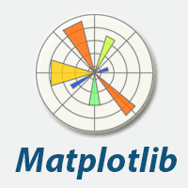





TOOLS USED

Slide 7
Objective:
Development and implementation of a predictive model for monitoring mushroom classification . The model will determines or classifies the given data of mushrooms as edible or poisonous.
Benefits:
Detection of upcoming frauds.
Gives better insight of customers base.
Helps in easy flow for managing resources.
Manual inspection if fraud is identified .

Slide 8
Data Sharing Agreement :
Sample file name : mushrooms.csv
Number of Columns : 23 feature columns.
Column data type : All features are categorical columns.

Slide 9
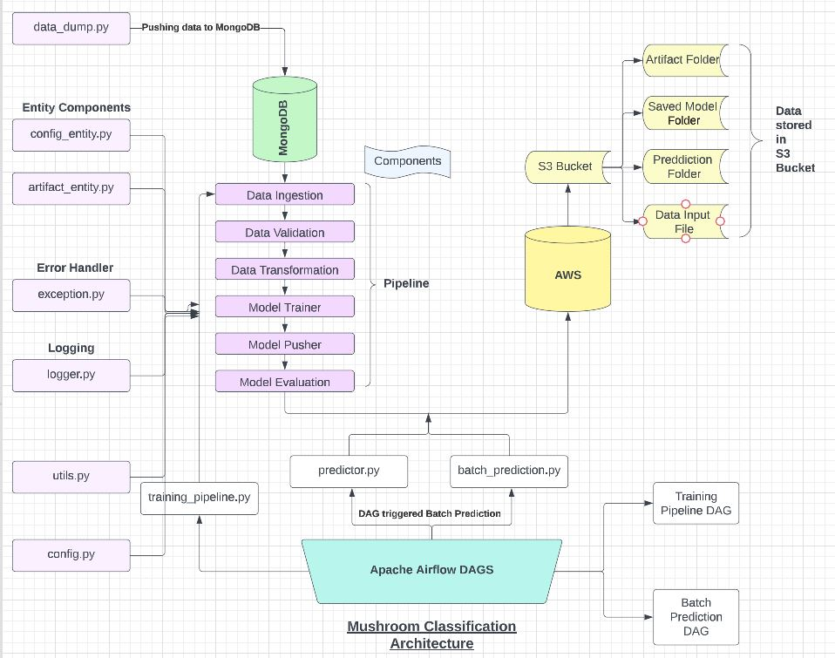
PROJECT ARCHITECTURE

Slide 10
ARCHITECTURE DESCRIPTION
The architecture is divided in 4 major parts :
1. Project : Contains main code of the code with all components , entity and utility function.
2. Apache Airflow : DAGS for triggering the training pipeline and batch prediction.
3. AWS : Deployment and storing data in S3 bucket
4. MongoDB : Storing data and passing live data to project.

Slide 11
Project structure
The project code has two files :
train_pipeline : It is used for starting the training pipeline.
batch_prediction : It is used for starting batch prediction.
The data is passed through following phases:
Data ingestion phase : The data is ingested from MongoDB database.
Data validation phase : Validation is performed over the given data.
Data transformation phase : Data is transformed using impting , scaling and made suitable for model trainning,.
Model trainer phase : Model is trained using XGBoost algorithm over the data passed through data transformation.
Model pusher phase : Model is pushed and saved in pickle form (pkl) which makes faster to use.
Model evaluation phase: Model is evaluated based on accuracy of current and previous models .
Project also include:
1 .Logger file : Logging information and can be used for debugging.
2. Exception file : Handling errors and exceptions.
3. Entity Folder : Consists configure entity for configuration and artifact entity for storing output.

Slide 12
AWS
AWS manages the infrastructure all the way to the hypervisor. Everything above that is your responsibility, like managing the guest operating system, the MySQL engine, or the data in it. Your e-commerce startup is responsible for updates and security patches, scaling, backups , etc .
AWS is used for deploying our project using :
EC2
ECR
S3 Bucket
It is used for storing prediction files in S3 bucket.

Slide 13
APACHE AIRFLOW
Apache air flow is used for triggering DAGS and can be used for making airflow APIS
DAGS can be used for triggering the pipeline on weekly or regular basis.
API can be used for sending GET or POST request using apache airflow.

Slide 14
MongoDB DATABASE
MongoDB is a source-available cross-platform document-oriented database program. Classified as a NoSQL database program, MongoDB uses JSON-like documents with optional schemas. MongoDB is developed by MongoDB Inc. and licensed under the Server Side Public License which is deemed non-free by several distributions
In our project mongodb is used for ingesting the data from its database to our pipeline it is also used for further live data which can be ingested on regular or weekly basis.

Slide 15
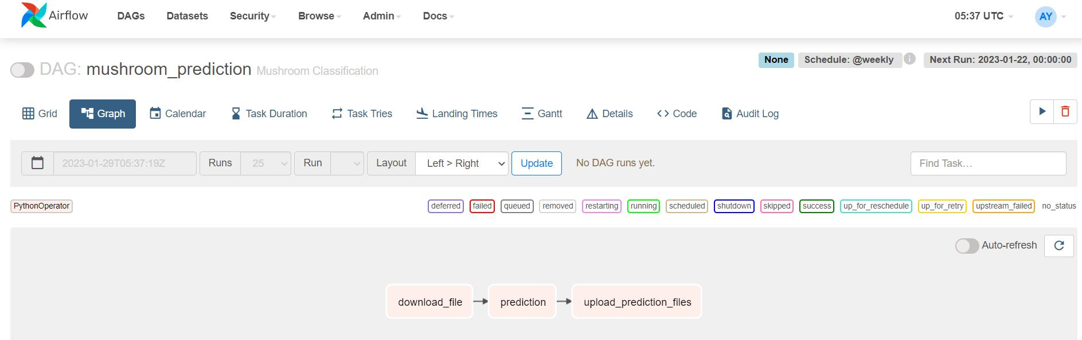
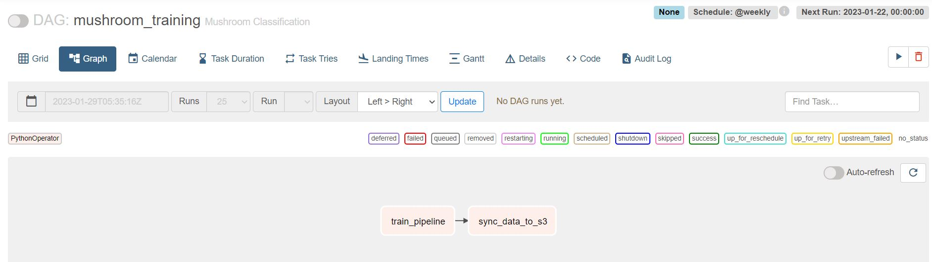
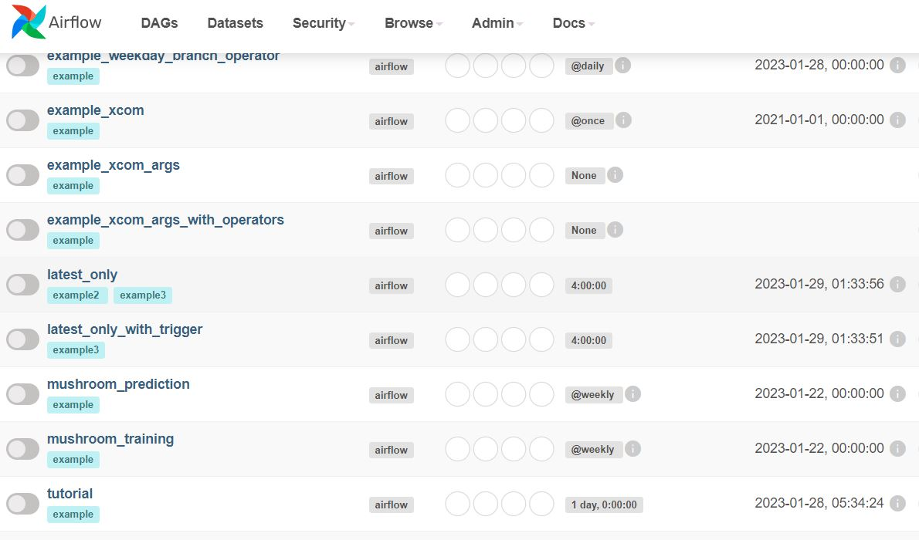
PROJECT OUTPUTS

Slide 16
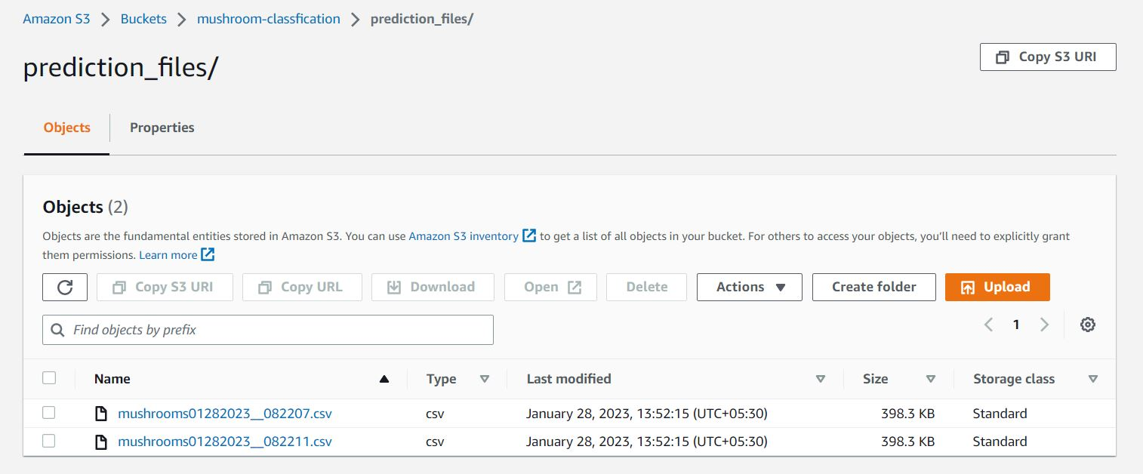
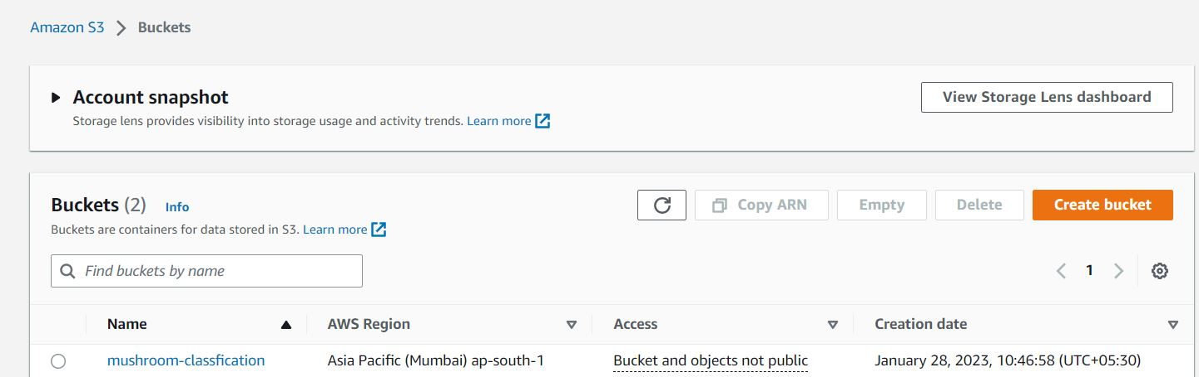
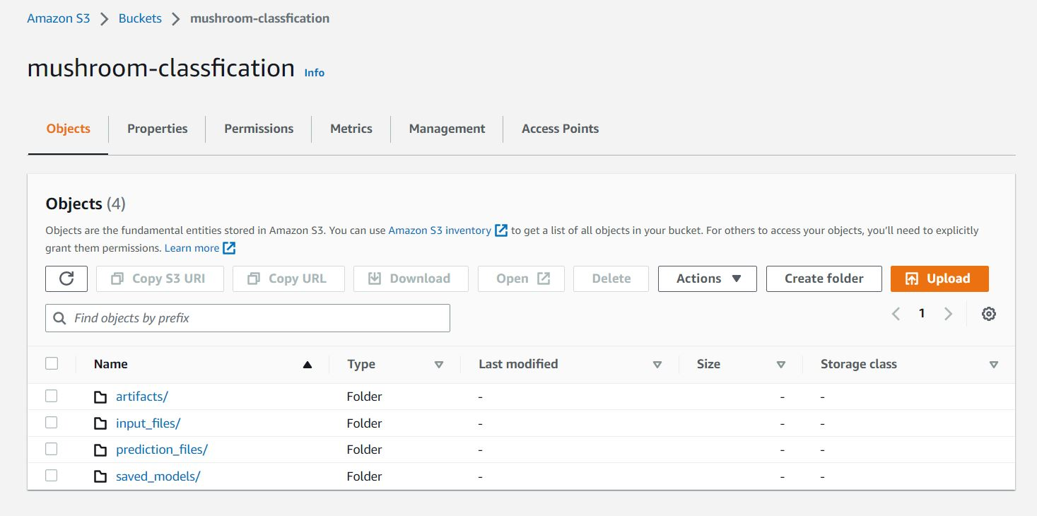
S3 bucket
The above images are from s3 bucket that is storing all prediction files along with artifact , saved_model and input_files.

Slide 17
MongoDB DATABASE
MongoDB is a source-available cross-platform document-oriented database program. Classified as a NoSQL database program, MongoDB uses JSON-like documents with optional schemas. MongoDB is developed by MongoDB Inc. and licensed under the Server Side Public License which is deemed non-free by several distributions
In our project mongodb is used for ingesting the data from its database to our pipeline it is also used for further live data which can be ingested on regular or weekly basis.

Slide 18
SUMMARY
The target column has 2 class type one is 'poisonous' which has 3916 counts and second is 'edible' which has 4208 counts so we have nearly equal counts for poisonous and edible classes in our data. Hence we can say that our data is balanced. 2. There are 4 types of cap-surface in a mushroom and also it suggests that 'edible' mushrooms do not have 'capsurface' : 'g : grooves' according to our data.
The mushroom may or may not have bruises but still it could be poisonous or edible according to our data.
The mushroom can have Gill Spacing as Close or Crowded but still it could be poisonous or edible according to our data.
The mushroom can have Gill Size as Narrow or Broad but still it could be poisonous or edible according to our data.  The 'edible' mushroom do not have Gill Color : Buff, Green and 'poisonous' mushroom do not have Gill Color : Red, Orange according to our data.
The 'poisonous' mushroom do not have Stalk Root as Rooted type according to our data.
The mushroom can have Stalk-Surface-Above-Ring as Smooth, Fibrous, Silky or Scaly but still it could be poisonous or edible according to our data.
The mushroom can have Stalk-Surface-Below-Ring as Smooth, Fibrous, Silky or Scaly but still it could be poisonous or edible according to our data.
The 'edible' mushroom do not have Ring-Type as Large and None and 'poisonous' mushroom do not have RingType as Flaring according to our data.
The 'edible' mushrooms do not have Spore-Print-Color as Green and 'poisonous' mushrooms do not have SporePrint-Color as Purple, Orange, Yellow, Buff according to our data.
The 'poisonous' mushrooms do not have Population Type as Numerous and Abundant according to our data.
The 'poisonous' mushrooms do not have Habitat Type as Waste according to our data.
The XGBoost Classifier model has ~ 100% accuracy on both training data and test data

Slide 19
Q & A:
Q1) What’s the source of data?
The source data used for training is taken from Kaggle and this data can also be live data which can be ingested . Data used is in .csv format (mushrooms.csv).
Q 2) What was the type of data?
The data has mostly categorical features which is need to be encoded using LabelEncoder.
Q 3) What’s the complete flow you followed in this Project?
The data flow is shown in project architecture.
Q 4) After the file validation what you do with incompatible file or files which didn’t pass the validation?
Files like these are moved to the archive Folder and a list of these files has been
shared with the client and we removed the bad data folder.

Slide 20
Q 5) How logs are managed?
For managing logs we are using logger.py python file which has various functions for maintaining logging info .
Q 6) What techniques were you using for data pre-processing?
Removing unwanted attributes or columns which are not required.
Visualizing relation of independent variables with each other and output variables
Checking and changing distribution of continuous values .
Removing outliers.
Replacing special characters with na and then imputing them using Standard Imputation ( strategy = most frequent).
Cleaning data and imputing if null values are present.
Converting categorical data into numeric values using Standard Scaler.

Slide 21
Q 7) How training was done or what models were used ?
Before diving the data in training and validation set we performed clustering over fit to divide the data into clusters.
As per cluster the training and validation data were divided.
The scaling was performed over training and validation data.
Algorithms like SVM , XGBoost , Catboost , Random Forest were used based on the recall final model were used for data and
then XGBoost was selected as it provided maximum efficiency and least cost.
Q 8) How Prediction was done?
The prediction is carried out and prediction is evaluated and all the files are stored in archive as predictions in the S3 bucket.

Slide 22
Q 9) What are the different stages of deployment?
The project is deployed using github and aws.
Github has two phases : Continuous delivery
Continuous deployment
AWS :
1. Create EC2 machine and create instance
2. Run docker commands and create image over EC2 machine
3. Deploy project thorugh github to AWS using apache airflow for triggering

Slide 23
THANK YOU

